Slide 1

Infection Prevention and Control (IPC) Team
Tanya Shaw and Cathryn Philpott

Slide 2
Outbreaks Q1 26-27
Infection | Number of Outbreaks Reported
Acute Respiratory Infections | 18
Covid – 19 | 2
Diarrhoea and/or Vomiting | 23
Scabies | 16
TOTAL | 59

Slide 3
Scabies
Operational pathway developed by ICB in 2024 – never finalised
New pathway developed by meds managements in the ICB for prophylaxis treatment of contacts, developed January 2026 – remains some confusion from primary care
ICB are now leading meetings (first one was this morning) to streamline response to incidents and outbreaks
All issues we have been collating have been presented

Slide 4
Do you have an ‘active’ IPC Care Champion?
The role needs visibility:
Display a photo on staff notice board
Explain the role at team meetings
Empower the IPC Care Champion as a leader:
Involve with audits, QI projects, outbreak handovers
Encourage lead on specific initiatives such as hand hygiene improvement
Support education/training:
Allow time for training and attend updates
Encourage cascade learning

Slide 5
Active IPC Care Champion
IPC should be everyone’s responsibility
Do staff feel comfortable raising IPC concerns?
Can the champion gather staff feedback and suggestions for improvement?
IPC Care Champion Network:
If a chain of homes, or neighbouring homes, could establish a network – learning from each other
Hold regular meetings with the IPC Care Champion
Involve residents and families:
Introduce the IPC Care Champion to residents and families at relative's meetings
Share outbreak information and learning through newsletters and noticeboards

Slide 6
Same Role…New Name?
From IPC Care Champion to IPC Link Practitioner…
Many reasons for relaunching the role – mainly to reignite engagement.
Free training:
IPC Care Champion Teams Drop in each month
Forums (UTI Workshops, RESTORE2 etc)
Will be launched at Awards Morning in October

Slide 7
IPC Care Champion Awards 2026
Planned for Tuesday 20th October
Nomination forms have been distributed. Categories are:
IPC Care Champion of the Year
IPC Campaign
Staff Motivator
Quality Improvement and Innovation Award
IPC Training Engagement Award
The awards ceremony aims to recognise the hard work, commitment, dedication and celebrate all those who have made outstanding contributions in their settings.

Slide 8

Reminder - Outbreak file
Contact page
Latest guidance - ARI pack, D&V, Scabies
Blank line list forms
Communication sheets (internal and external)
Reflection sheet
Blank touch point cleaning schedules
Should be to hand when IPC phone

Slide 9
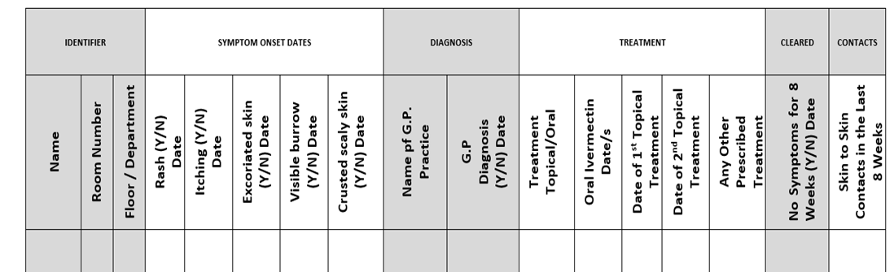

Reminder: Line Lists
A line list contains key information about each case in an outbreak.
Provides a clear overview of the outbreak in terms of person, placement and time information.

Slide 10
There’s something about Audits…
Every audit is an opportunity to improve care, reduce risk and enhance quality.
Audits start with a question: ‘How do we know we’re providing safe, high-quality care?’

Slide 11
Coming up in Q2 & Q3…
Fundamentals of IPC – webinar and e-learning
RESTORE2 – webinars
Scenario based outbreak simulations – face to face
Infections Uncovered - webinars
The Good, The Fed and The Hydrated Resident Awareness Sessions – face to face
Quality Improvement training – face to face
Bespoke training

Slide 12

Thank You
infectionprevention@lancashire.gov.uk

