Slide 1
Notes:
Slide 1
Introduce Road Safety Week 2024
Explain that Road Safety Week is the UK’s biggest road safety event and it happens every year.
Explain that Road Safety Week 2024 is taking place this week (17-23 November) and that you will talking about Road Safety Heroes.
Explain that everyone who helps make journeys safer and healthier or helps care for someone after a crash is a road safety hero.
A note about sensitivity
Discussions about road safety should be approached with care. If you are aware that a pupil has been affected by a road crash, either directly or indirectly, please talk to them and their parent or carer before involving them in any Road Safety Week activities. Please take individual needs into consideration when planning your activities and carry out risk assessments where required. The road safety animation explains that sometimes people get badly hurt in crashes and sometimes people die. Please watch the film before presenting it in assembly.
Move to next slide

Slide 2
Notes:
Slide 2
What is a hero?
Ask the children for examples of what it means to be a hero.
Suggestions could include:
Helping someone in trouble
Working really hard to overcome difficulty
Doing something really well
Being really brave
Having superhuman powers
Ask children to give examples of famous people who they think are heroes, or examples of when they have been a hero, or when they have been helped by someone who is a hero. Give an example of someone who you think is a hero.
Explain that these are really good examples of being a hero.
Say that today you are going to talk about road safety heroes.
Explain that everyone who helps make journeys safer and healthier or helps care for someone after a crash is a road safety hero.
Move to next slide

Slide 3
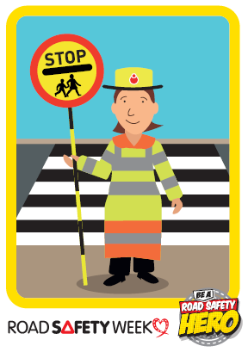
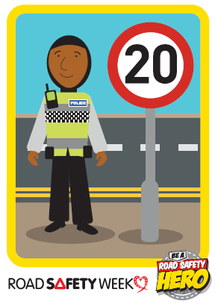
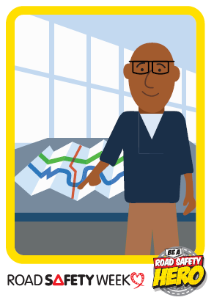
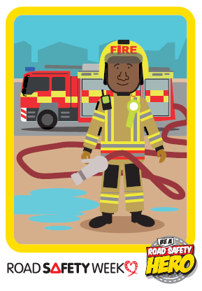
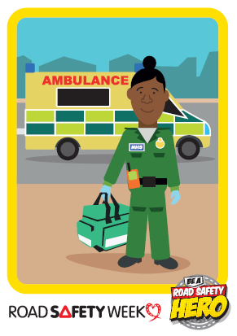
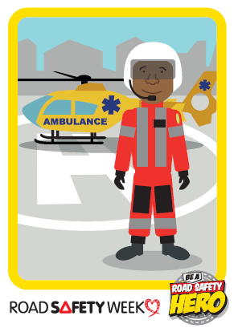
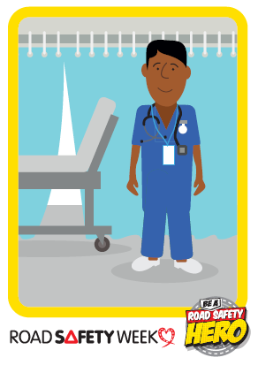
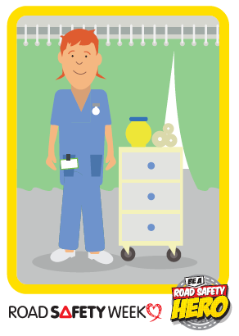
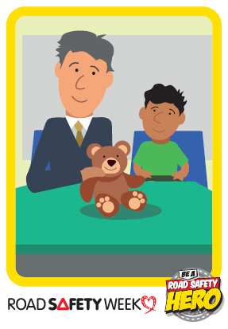
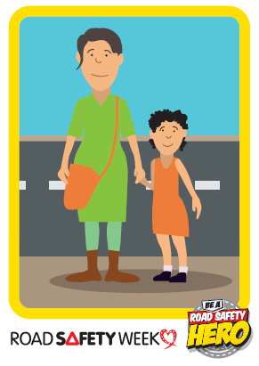
Notes:
Slide 3
Talk about Road Safety Heroes.
Remind children that everyone who helps make journeys safer and healthier or helps care for someone after a crash is a road safety hero.
Ask children if they know any road safety heroes. Examples could be doctors, nurses, paramedics, fire officers, police officers, road designers, engineers, driving instructors, etc.
Here are some examples of road safety heroes:
School crossing patrols
Roads policing officers
Road designers and highway engineers
Fire and rescue services
Ambulance services
Medical staff in hospitals
Other health professionals
Police family liaison officers
Support services
Road safety charities
Road crash victims
Parents and carers
Employers
Everyone who uses roads safely to protect themselves and others.
You can use the factsheet for educators in your Road Safety Week action pack for more detail about each road safety hero.
Why do we need Road Safety Heroes?
Most of the time, people move about without being hurt by traffic. But sometimes traffic hurts people. This is called a road crash. Sometimes traffic is so fast it’s difficult to see it coming… and difficult to get out of its way.
When a vehicle crashes into people, whether they are walking or cycling, it can hit them very hard, or run them over and squash them. This is because traffic is fast and heavy and made of metal.
Sometimes their legs or arms are hurt and don’t work anymore. Sometimes people die. This can sometimes happen if their brain or heart has been badly hurt.
If a car hits another car, it can hurt the people inside the cars.
Say that this isn’t a very nice fact to hear but that every day a lot of people are killed and badly inured in road crashes, including children.
Share some of the following statistics if appropriate:
More than 1.3 million people die on roads every year
Road crashes are the leading cause of death for children and young people worldwide
More than six children are killed or seriously injured on roads every day in the UK
Road crashes have a devastating effect on families and communities
Pollution from traffic causes respiratory illnesses and other diseases
Active travel such as walking and cycling is good for the nation’s health and good for the planet
Good post-crash care is essential to save lives and prevent life-changing injuries.
References:
World Health Organisation (2023) Global Status Report on Road Safety 2023. www.who.int/teams/social-determinants-of-health/safety-and-mobility/global-status-report-on-road-safety-2023
Department for Transport (2024) Reported Road Casualties in Great Britain: 2023 Annual Report and associated data sets. www.gov.uk/government/statistics/reported-road-casualties-great-britain-annual-report-2023
Move to next slide

Slide 4
Notes:
Slide 4
Explain that you are going to watch a short film about Road Safety Heroes.
Play the ‘Our road safety heroes’ film (2 minutes)
Our Road Safety Heroes
This short film is aimed at helping children explains how road safety heroes make journeys safer for everyone and help people after a crash. It also explains how we can all be road safety heroes by using roads safely to protect ourselves and others.
The film is published on Brake’s YouTube channel at https://youtu.be/j_Z-f_QyAJw
Use the embed code to add the film to Powerpoint: <iframe width="720" height="406" src="https://www.youtube.com/embed/j_Z-f_QyAJw" title="Our road safety heroes" frameborder="0" allow="accelerometer; autoplay; clipboard-write; encrypted-media; gyroscope; picture-in-picture; web-share" referrerpolicy="strict-origin-when-cross-origin" allowfullscreen></iframe>
Move to next slide

Slide 5
Notes:
Slide 5
[Add a picture of your road safety hero on the slide]
Who are our road safety heroes?
If you have completed the Art lesson in the lesson plans in your Road Safety Week action pack, prepare a few children to display the poster they have made and say who their road safety hero is, and why.
Now explain to children that you are now going to introduce someone (or more than one person) who is a real-life road safety hero.
Invite someone from your community to talk about the work they do to help make journeys or help people after a crash.
Examples could be:
Police
Fire service
Ambulance
Air ambulance
Medical staff
Local road safety officer
School crossing patrol
Cycle trainer
Introduce your visitor and ask them to give a short talk about the work they do.
Move to next slide

Slide 6
Notes:
Slide 6
Road Safety Heroes Awards
Say that Road Safety Week is a great time to celebrate the work of people who help make journeys safer for everyone and say thank you to people who help other people after a road crash.
Say that you are now going to present your school’s Road Safety Heroes Awards to celebrate the road safety heroes in your community.
Examples of people you can present awards to include:
Parents/carers who work for emergency services
Your local road safety officer
Your school crossing patrol
Someone who has campaigned for road safety for your school
Cycle trainer
Members of emergency services that you have invited to attend your assembly.
Ask children to present the awards explaining to each person why they are a road safety hero.
If you’ve ordered stickers from the Brake shop you can present these.
You could also print the certificates in your Road Safety Week action pack and present these.
Please share photos of your awards on social media. Please tag us @brakecharity and use #RoadSafetyWeek.
Next slide

Slide 7
Notes:
Slide 7
Everyone can be a road safety hero
Remind the children that you are taking part in Road Safety Week and talking about road safety heroes.
Tell them that everyone can be a road safety hero by using roads safely to protect themselves and others and speaking up for road safety.
Ask them to think about how they can be a road safety hero by using roads safely.
Explain that their grown ups can be road safety heroes too.
Say to younger children that they should always hold hands with a grown-up when walking near roads. They should use safe footpaths away from traffic and always cross roads at safe places with a grown up. When riding their bikes, they should ride their bike with a grown up on a safe path away from traffic and wear a helmet to protect their head if they fall off. They should always sit in a special car seat to protect them when travelling by car.
Remind older children that we all share a responsibility to use roads safely, and this includes people who walk, scoot and ride, as well as people who drive. Say that they shouldn’t use their phone when walking near roads/crossing roads and they should play in safe places away from traffic. Children can talk to their parents or carers and remind them to drive at safe speeds, especially in areas where people live, work and play; to never use their phone while driving; and to always wear a seat belt.
Talk about any Road Safety Week activities that your school will be doing. There are resources to support all these activities in your Road Safety Week action pack.
For example, you might be:
- Talking about road safety in lessons or group activities
- Using the colouring sheets, activity sheets or postcards and asking children to take them home so they can talk to their parents/carers about important road safety messages.
- Making a display at school out of the artwork they have made during Road Safety Week
- Taking photos using Road Safety Week campaign boards (if you have ordered these) and sharing them to celebrate the road safety heroes in your community
- Taking part in fundraising events, to raise money for Brake.
Find out more about fundraising during Road Safety Week at www.brake.org.uk/road-safety-week/fundraise.
Fundraising for Brake helps our vital work supporting families affected by road crashes and campaigning for safer roads for everyone. All efforts to fundraise for Brake during Road Safety Week are greatly appreciated.
Explain that the children will be learning a lot more about road safety throughout the week
Thank you and summary
Thank children for listening. Remind them that it is Road Safety Week and that they can all make a difference to road safety in their communities. They can be good role models, and use roads safely, celebrate the work of road safety heroes and ask grown ups to help keep them safe near roads.
Remind them that they might be talking about road safety in other lessons this week.
If you have a school council ask their representatives to discuss the issues raised in this assembly at their next meeting and to suggest ideas for how they could get more involved in road safety.
Thank them for listening and say that they are all road safety heroes.
END

