Slide 1


JESIP Awareness
GET IN TOUCH
lrfsecretariat@lancshire.police.uk

Slide 2

JESIP
JESIP is a UK framework enhancing emergency responders' interoperability to improve communication and coordination.
JESIP is not a command structure or specialist training but a shared language and approach for responders.
JESIP supports responders, and providers, by reducing confusion.
www.jesip.org.uk

Slide 3
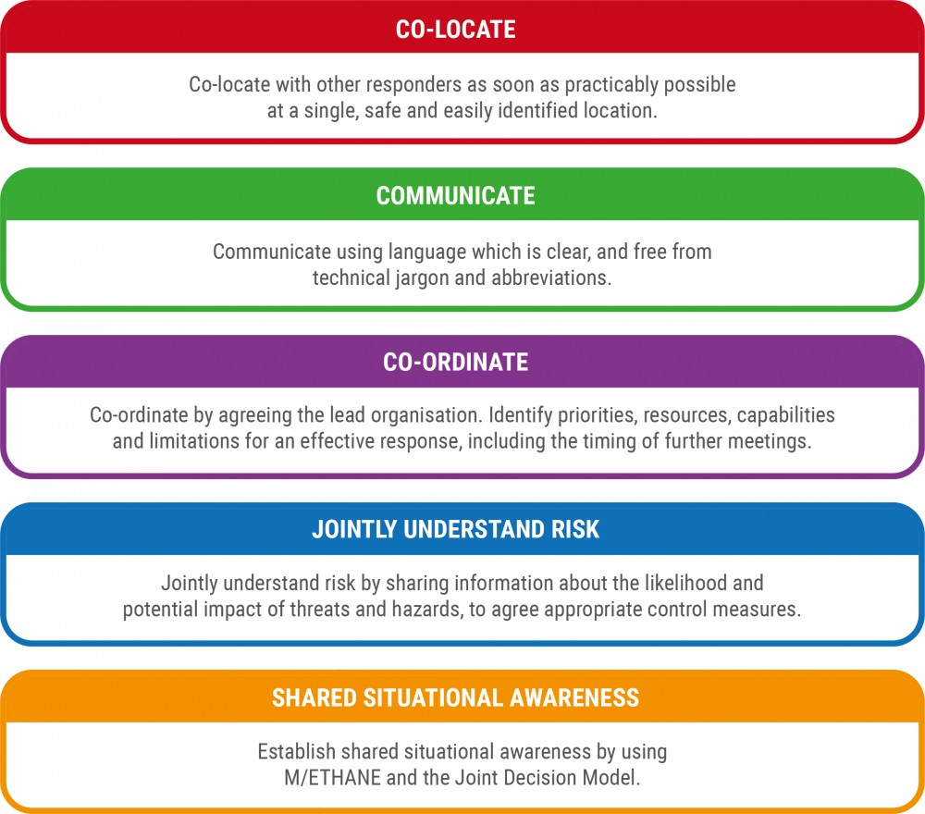
Principles for Joint Working

Slide 4
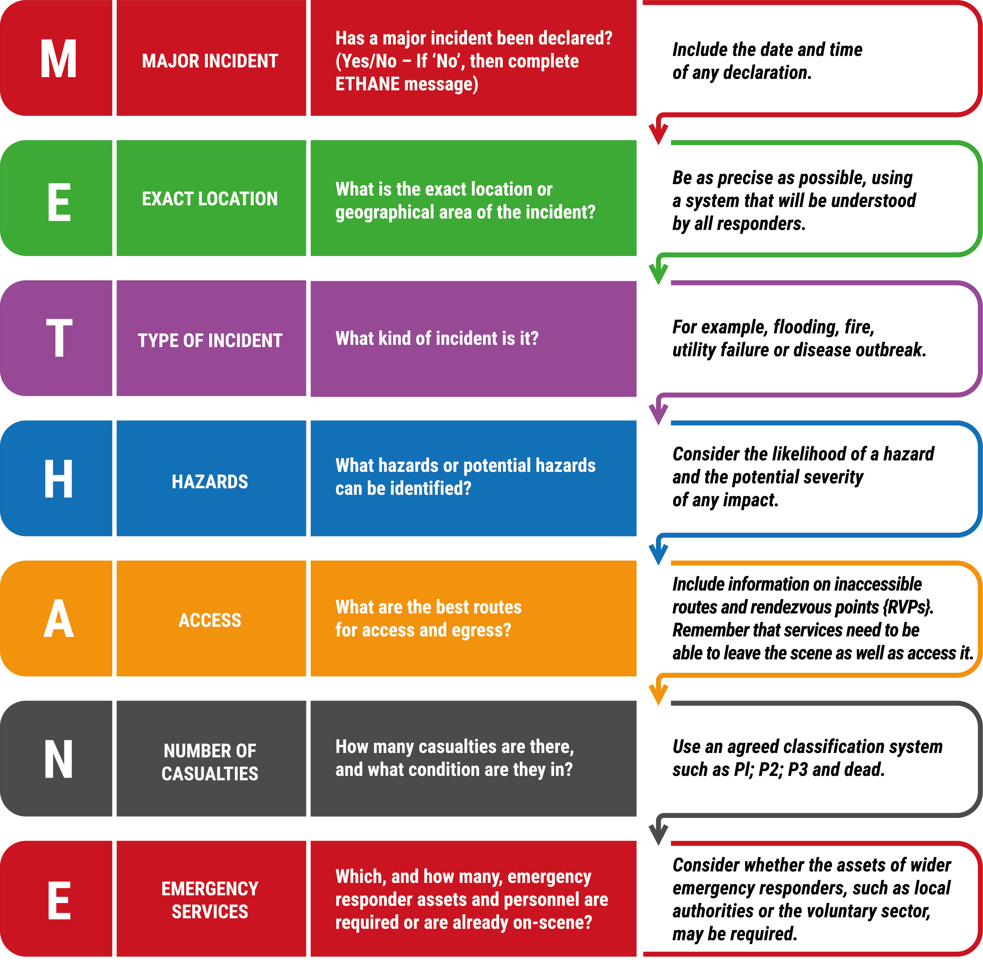
M/ETHANE
Notes:
Exact location: Rosewood Care Home, Preston
Type: Fire in laundry room
Hazards: Smoke, oxygen cylinders
Access: Main entrance clear
Casualties: 2 residents affected by smoke
Emergency Services: Fire and Ambulance requested

Slide 5
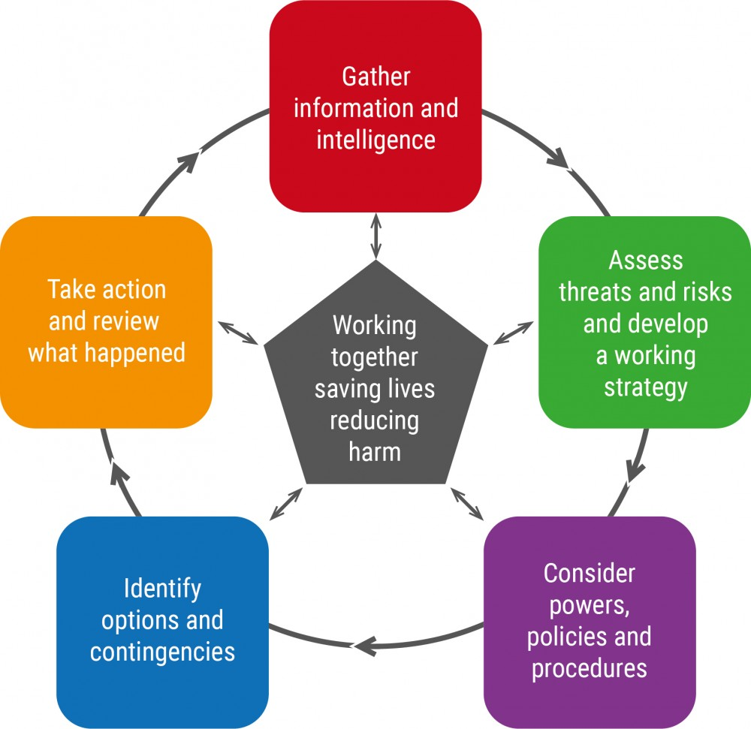
Joint Decision Model
Notes:
The Joint Decision Model (JDM)is designed to help make effective decisions together. As shared situational awareness is established, a Common Operating Picture (COP) is formed.
The priority is to gather and assess information/intelligence. Responders should work together to build shared situational awareness, recognising this requires continuous effort as the situation, and responders’ understanding, will change over time.
Understanding the risks establishes shared situational awareness and enables responders to answer the three fundamental questions of ‘what, so what, what might?’
Once the process of building shared situational awareness has begun, the desired outcomes should be agreed as the central part of a joint working strategy. If a SCG is convened, they will agree and share the joint strategy for the multi-agency response.

Slide 6
Operational Response
Central Government Response Including:
Cabinet Office Briefing Room (COBR)
(Lead) Government Department
Ministry of Housing Communities and Local Government (MHCLG)
STRATEGIC
Strategic Coordinating Group (SCG)
Sets the strategic direction
Coordinates responder agencies
Prioritises resources
TACTICAL
Tactical Coordinating
Group (TCG)
Develops the tactical plan to deliver
against strategic objectives
Coordinates activities and assets
in areas of operations.
OPERATIONAL
Executes the tactical plan
Commands single service response
Coordinates at the scene
Police
Fire
Ambulance
Other Responders

Slide 7
Key Messages
Maintain up-to-date emergency plans.
Staff should complete the JESIP e-learning module.
Use METHANE to provide clear information.
When attending JESIP meetings, be mindful of the Principles of Joint Working.
www.jesip.org.uk/training/all-staff-e-learning/

